Slide 1
Lake Travis FFA Alumni
September 13, 2022

Slide 2
Agenda
Student Meeting
Introduction of Student Officers, Advisors & Alumni Board Members
Dismiss Students to Species Meetings
Who are the FFA Alumni?
What are Expectations of LT FFA Alumni?
Old Business
Treasurer Report
New Business
Sponsorship Update
Major Alumni Events/Social Events
Important Dates
Teacher Update
What’s on the Web Site?
What’s next?

Slide 3
Student Meeting

Slide 4
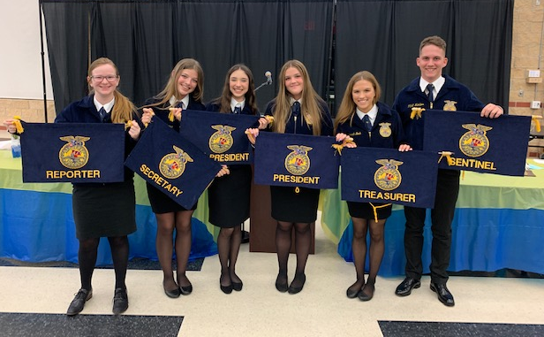
2022-2023 Student Officers
President: Jenna Dow
Vice President: Maddie Fisher
Secretary: Morgan Ambrose
Treasurer: Brianna Noak
Reporter: Lauren Gormley
Sentinel: Larson Noak

Slide 5
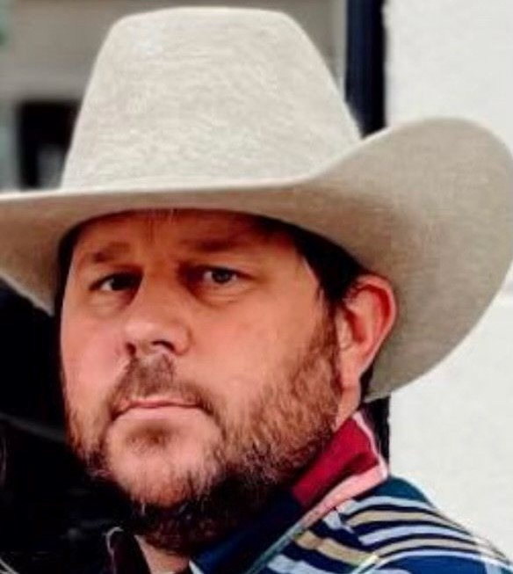
Faculty Advisors
Mr. K. White whitek@ltisdschools.org
512-533-6089
Mr. P. White
whitep@ltisdschools.org
512-533-5921
Mr. Fleming
flemingj@ltisdschools.org
512-533-7751

Slide 6
Student Species Meeting
Students are dismissed at this time.

Slide 7
Who are the FFA Alumni?
Kathleen F.
Former FFA members and interested adults are a natural, supportive resource for FFA advisors and their students. A National FFA Alumni Chapter helps to rally the local community around agricultural education and FFA activities.
FFA alumni chapters also provide a helping hand to FFA advisors in coordinating activities for the local FFA chapter.

Slide 8
Expectations of LT FFA Alumni
Kathleen F.
Join FFA “Alumni” organization (AKA: Booster Club); yearly dues for family are $60. Individual is $40 per person.
Volunteer and Family Contributions:
Attend/volunteer chapter and alumni events (Meetings, fundraisers)
Attend/volunteer with chapter shows (Cav Classic, Chapter Show, TCYS)
Participate on one alumni committee (HOCO, Show committees, sponsorship, etc.)
Sponsorship/family contribution = $500
Notes:
At least one yearly committee (signup genius to go out after meeting)
Cavalier Classic (our major fundraising show in November – volunteer with pen set-up, tear-down, day of event)
TCYS pen set-up or tear down
Pet Shot Clinic
Family contribution through sponsorships or donations of $500
Monthly meeting attendance
Support kids by helping out at shows and around the barns as needed

Slide 9
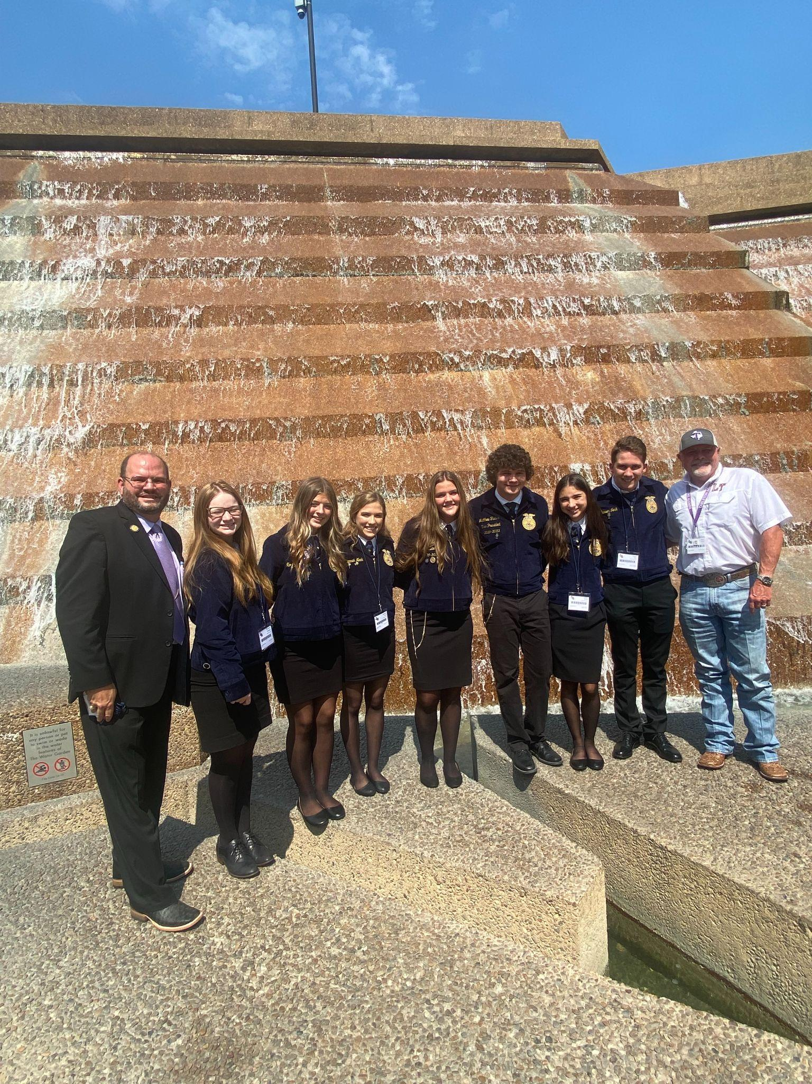
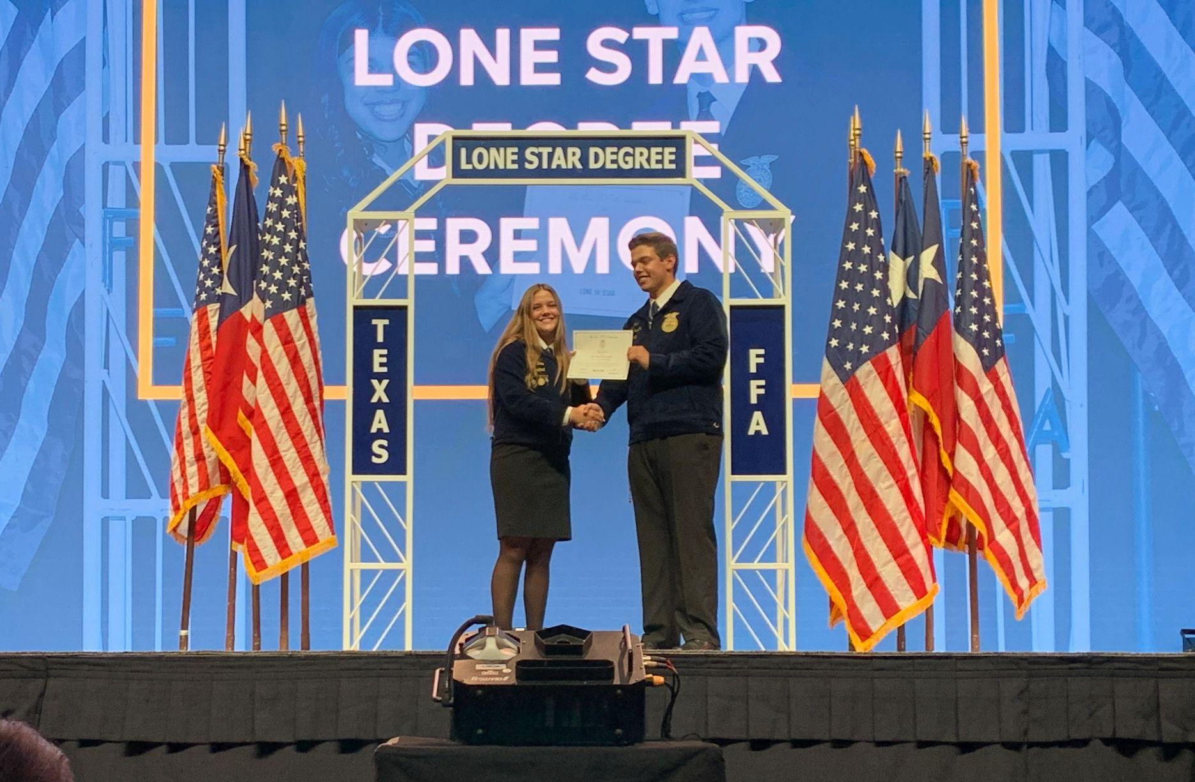
Old Business
Kathleen F.
Banking change to A+ Federal Credit Union
LT FFA attended State Convention in Fort Worth in July
Six students attended
Two Lonestar Degree awards
Outstanding Alumni chapter of the Year award

Slide 10
Treasurer’s Report
Jenn D.
Summer Net Cash Flow
Up $3,740.53
Expenses: $3,263,98
Operating Expenses: $231.26
Chapter Support: $607.72
Sponsorships: $175
Senior Scholarships: $2,250
Income: $7,004.51
General Fundraising: $1,504.51
Sponsorships: $5,500

Slide 11
New Business
Kathleen F.
Budget Review at October Meeting
Special thanks: Kelli Beck display cabinets in Ag Building, Wild Hare Construction contributions in the barn, Holly Noak sponsorship drive, Susan Dow for keeping us “in the news” in Mrs. Garinger’s school newsletters! Cav Classic committee working to get event up and running!
Monthly Email newsletters – make sure we have your email address!
Volunteers needed! (look for sign up email soon) – Need a HOCO chair ASAP!

Slide 12
Sponsorship Update
Jenn D.
2022-2023 Fundraising goal = $35,000!
Sponsorship Drive: $10,150 total value & $7,650 in cash to date
Need both local businesses and show sponsors
Committee Volunteers needed for follow up
Can work off hours toward your $500 family contribution
Contact: Holly Noak, 512-657-6940

Slide 13
2022 - 2023 LT FFA Sponsors
Thank you!!
Diamond
H&H Ranch Lakeway
Wild Hare Construction
Gold
Spicewood Vet Clinic
The Foxx Family
Silver
A+ Federal Credit Union
Nitro Swimming
The Wise Family
McCoys Building & Supply (Bee Cave)
Bronze
VIK Complete Care
Lakeway Vision Associates
Flipnastics
Evans Livestock
Ben Archer - State Farm
Shout outs to Triple S Feed & General Store, Hillside Dentistry, & Cafe Lago!

Slide 14
Major Chapter Events
Kathleen F.
Pet Shot Clinic & P.Terry’s Spirit Night
Fundraiser - Students & some parent members will need to help in some way!
Fall: October 24th, 5-7pm
Spring: Date TBD
Cav Classic Stock Show Fundraiser - Student & parent members will need to help in some way!
Set -up: November 10th
Show: November 12th
LT FFA Chapter Show December 10th - Playoffs or NOT. “ THE SHOW MUST GO ON!”
TCYS est Jan 12-15th, $ale Jan 20th - Let an Ag Teacher know asap if you need an animal; begin thinking about youth fair projects (category lists available on TCYS web site or the LT FFA website)

Slide 15
Alumni Social Events

Slide 16
Alumni Social Events

Slide 17
Mark Your Calendar
P. White
Next meeting: October 4th, 6pm (First Tues. of month/Ag Bldg.)
Homecoming Parade: October 5th, 5-8pm
Lamb/Goat Validation: ~ Oct 18th @ Hendrickson’s Farm
1st Pet Shot Clinic: Oct 24th, 5-7pm
TCYS Entry Deadline: November 15
Cavalier Classic: November 12th, all day!
LT Chapter Show: Dec 10th
Swine (pig) Validation: TBD

Slide 18
Teacher Update
P. White

Slide 19
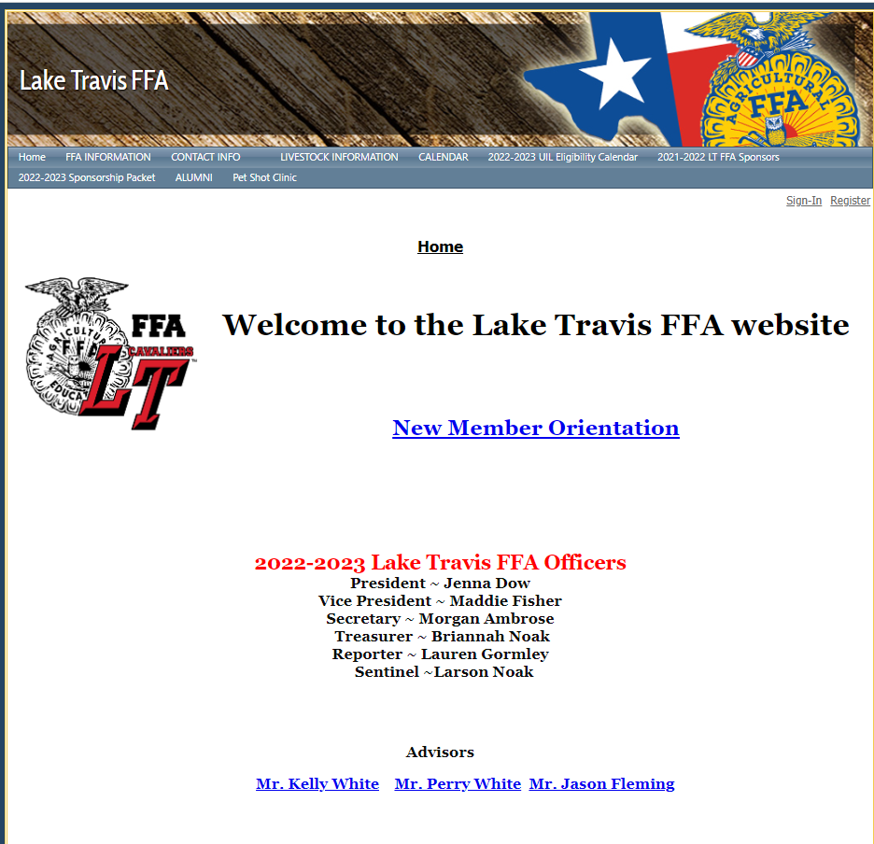
What’s on the Web Site
http://www.laketravisffa.ffanow.org

Slide 20
What Should I Do Now?
Kathleen F.
Join students in species meetings if raising an animal
Let an Ag Teacher know if raising an animal ASAP
Pay dues, sign up for volunteer commitments, solicit sponsorships/personal donation
Sign up for email newsletter and remind groups
Decide what youth fair projects your student will want to do at Travis County Youth Show (TCYS)
Help your student decide what fall events to participate in (Leadership Development Events/LDEs)

Slide 21
Join Remind Group Alerts
Text number: 81010
•FFA Texts - @lt-ffa
•Pigs - @oinker
•Goats - @ltgoat
•Lambs - @ltlambs

Slide 22
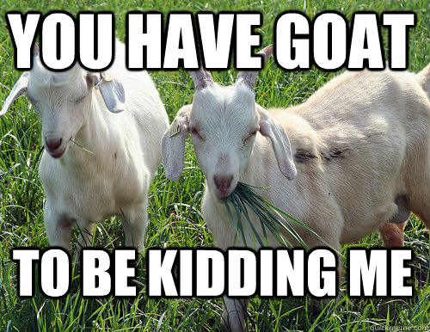
Questions

Slide 23
Next Meeting October 4
Meeting
Adjourned
Thank you for attending

